Slide 1
Topic 2 – Intro to Data Science
Statistics and Data Analysis
COR1-GB.1305
Prof: Chris Volinsky
NYU Stern: Fall 2023

Slide 2

What is Data Science?
The science of extracting knowledge and insights from data
“Data science is just statistics with better marketing” - unknown
Stats | Data Science
Distribution focused | Data focused
Focused on models for understanding variable relationships | Focused on algorithms for prediction
Relatively small, clean data sets | Real-world, large, messy data
Used for scientific understanding | Used in business production systems
Starts with hypotheses | Can be exploratory
Obsessed with significance | ¯\_(ツ)_/¯
Notes:
What fields are related to data science?
What distinguishes these fields?
Statistics
Statistical Learning
Data Mining
Machine Learning
AI

Slide 3

Jobs in Data Science
This is a gross oversimplification and many things to argue about…
Job Title | Role
Data Analyst | Understands data, can do some analysis and make reports | Excel!
Data Engineer | Builds, tests and maintains infrastructure for analysis, manages large scale data sets and architectures for modelling | Databases!
ML Engineer | Designs and implements ML learning applications in production | Systems!
Business Intelligence Developer | Business knowledge, assist business clients in quickly finding information through tools and visualizations | Dashboards!
Data Scientist | Advanced analytics, machine learning, and statistical analysis combined with business acumen
Also many data-science adjacent positions…
Notes:
Consultant – need to understand it
Venture Cap
Can you ask intelligent questions? Can you challenge the evaluation?
Tie back to the survey – what roles do you think you might have.

Slide 4
Data Science Success Stories
Retail & E-Commerce
Amazon: Personalized product recommendations.
Walmart: Supply chain optimization and inventory management.
Banking & Finance
Credit Card Fraud Detection: Using transaction data to identify fraudulent activities.
Signet Bank example [DSB]
Healthcare
Predictive Analytics: Early disease detection and patient care optimization.
Entertainment
Netflix & Spotify: Personalizing viewing and listening experiences.
Sports Analytics
Moneyball (Baseball): Data-driven team assembly and performance strategies.
Notes:
Have them come up with these

Slide 5
Data Science Success Stories
Social Media
Targeted Advertising: Personalized ads based on user interests.
Transportation
Uber & Lyft: Price surge forecasting, optimal routing, driver-passenger matching.
Environmental Monitoring
Climate Change Analysis: Studying weather patterns and environmental impact.
Manufacturing
Predictive Maintenance: Anticipating equipment failures for timely maintenance.
Public Sector
Crime Prevention & Smart Cities: Enhancing urban living and safety
Notes:
Have them come up with these

Slide 6
Our First Use Case: Nadia / MegaTelCo Churn
Nadia, a Data Science Product Manager, has just joined MegaTelCo, one of the largest telecommunication firms. MegaTelco is having a major problem with churn in their wireless business.
20% of cell-phone customers leave when their contracts expire
hard to get new customers
Marketing has designed a special retention offer that might be able to convince customers to stay.
What is the business relevance?
What is the goal of the data science exercise?
What is the outcome, or action, that will come from the data science task?
What data could you use?
How will you measure success?
Notes:
What is churn? Why is it important?
One basis point = bp = .0001 x 80M = 8000 customers you save with one bp improvement of churn x $100 per month = 800k x 12 = 9.6M
What is the offer?
How good is the offer, do you think it is worthwhile?
Expected take rates?
What is success?
Goal is not who is going to leave! It is who to send the marketing to!
Big question to small question.
What is the action?? Offer. Very clear here but not always so.
Will our action solve the big problrm? Don’t know!!
What comes from the algorithm?
We also need decision logic.
What is the outcome? Who to send the plan to, or who will take the plan, or who will leave?
Or who will be impacted by the plan? These are all different things!
Final question…why not just make the offer to everybody?

Slide 7
Data Science - Process

Slide 8
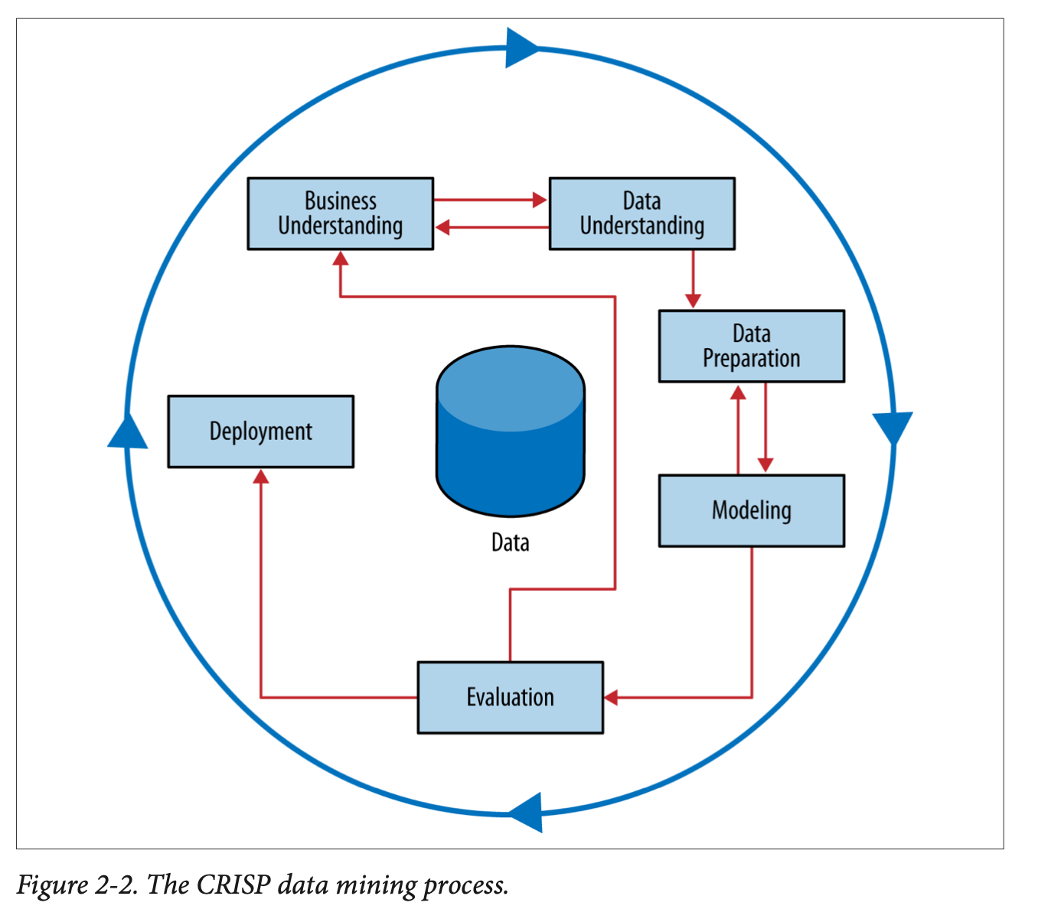
Data Science Process
CRISP-DM =
Cross-Industry Standard Process for Data Mining
Notes:
Work through this on board…
Why a process? Discuss analytics as a craft…this should not be viewed as a formula…more like an “artistic process” – tools, knowledge, experience, common sense.
When to be creative and when to trust the science.

Slide 9
CRISP: Business Understanding
Notes:
Do something more illustrative than a table.

Slide 10


Business Understanding
Data Science should typically be driven by a key business question
Avoid the “big data pipe dream”
Let’s tell our data scientists to use AI to raise revenue and cut costs!!
Try and break big questions into smaller questions that are answerable by data:
Big questions:
How do we increase revenue?
How do we diversify customers?
Why is customer satisfaction down?
Smaller (answerable) questions:
What trends do we see in customer spending?
Which segments of population perform poorly?
What strategies reduce customer service hold times?
10
Notes:
10
Sometimes you do start with a data set and do exploratory work…but that is only typically to do hypothesis generation, and then the questions get more defined
Clustering as an example - why?

Slide 11
Business Understanding
Put the problem into context…ask questions…be creative!
Who are the stakeholders?
Be prepared to ask…
What is the goal of the solution?
Why do we need to do this?
What data is available?
What constraints exist?
What is an acceptable solution?
How do we measure?
What is success?
Executive
Sales
Marketing
Technology
Operations
Who cares about the outcome?
Who will use it ?
How will they act?
Notes:
Think about churn…there are different stakeholders with different goals! Who is your client, what is best for the company.
WHAT IS THE ACTION?
Maybe biggest cause of churn is poor signal strength…what can you do?
Lesser cause of churn is bill surprise – but maybe this is more actionable..
There are short term, local goals, and there are longer term needs of the businsess.
You can increase sales by offering 50% discount! Yay! What is wrong with that?
You can decrease churn by offering 3 months free.
people who call customer care every day...why?

Slide 12

Business Understanding
We collect so much great data on our business, can you do some machine learning on it?

Slide 13
CRISP: Data Understanding

Slide 14
Data
We will spend a lot of time talking about data…
Know where your data comes from
Good to have a contact to be able to explain how the data was created
Know how to get the data
What systems, tools, etc
Know what your data looks like
Spend time with EDA (exploratory data analysis)
Know the limits of your data
Need to spend time cleaning the data, caring for it, understanding it
Notes:
HBO Max example – no info on time or scrolling
15k minutes of watching in a week…does this make sense?
There are less than that, but maybe multiple devices…so we figured ok,
But device times out after a certain time…
Also – don’t always know what your data is : account vs. phone..someone bad experience but one phone in family plan

Slide 15
CRISP: Data Preparation for Modeling
Data Prep involves:
Exploratory Data Analysis
Missing data analysis
Outlier detection and assessment
Feature engineering
Data Munging (ugh.)
We will cover all of this!
Notes:
where most of your time is spent

Slide 16
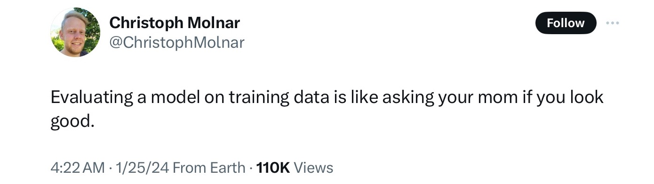
Training and Test sets
This is a core concept in data science / machine learning that separates it from statistics
Why do we need to split data into a training and test sets?
Notes:
Do not want to “memorize” patterns from the training data…

Slide 17

Training and Test sets
This is a core concept in data science / machine learning that separates it from statistics
Randomly partition labeled data into training and test set
Training set – data used to train/build the model.
Estimate parameters (e.g., for a linear regression), build decision tree, build artificial network, etc.
Test set – a set of examples not used to fit the model. This gives us a better assessment of the model’s performance – on “unseen” data. Also referred to as out-of-sample data
Generalization Error: Model’s error on the test data.
Comes later…gives a ‘real-world’ sense of how good the model is and if we need to adjust
Original data
Training Data
(80%?)
Test data
(20%?)
deployment examples

Slide 18
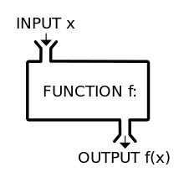
CRISP: Modelling
Modelling
This is the fun stuff!
But it is only meaningful with all of the rest
We will talk a lot about this part!
Notes:
ML – what is it?
Really just a function to take inputs and create outputs. A lot more goes in but that is basic.
Its a function to create a function!

Slide 19
CRISP: Modelling
What data science models (algorithms) do you know?

Slide 20

Statistics v. Data Science
Statistician: the only valid way to test a theory is to come up with a carefully constructed hypothesis and then collect data in a randomized controlled manner so we can correct for all possible confounding variables and assure ourselves of no bias!
Data Scientist: Whatevs! We’ve got lots of data – best prediction wins!!!!
[statistician and data scientist having a polite debate]
Notes:
What are the pros and cons of these takes?

Slide 21
CRISP: Evaluation
Notes:
Do something more illustrative than a table.

Slide 22
Data Process - Evaluation
There are many different ways to evaluate data science output
Only some of them have to do with numeric evaluation of algorithms
RMSE
Accuracy
ROC curves
Requires having a well-thought out measure of success
Evaluation as a process needs to be more holistic
Can you think of an example where a model performs well at its prediction task, but ends up being negative for the firm?
Notes:
- short term benefit for long term loss
- benefit to one team but not to the company as a whole
- or a blind spot leads to bias in deployment

Slide 23
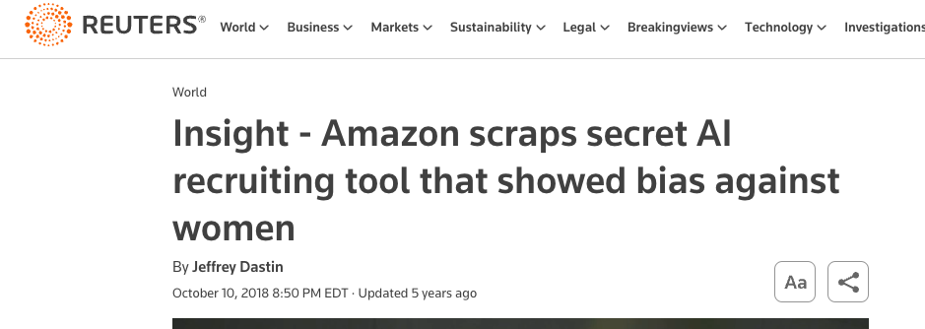
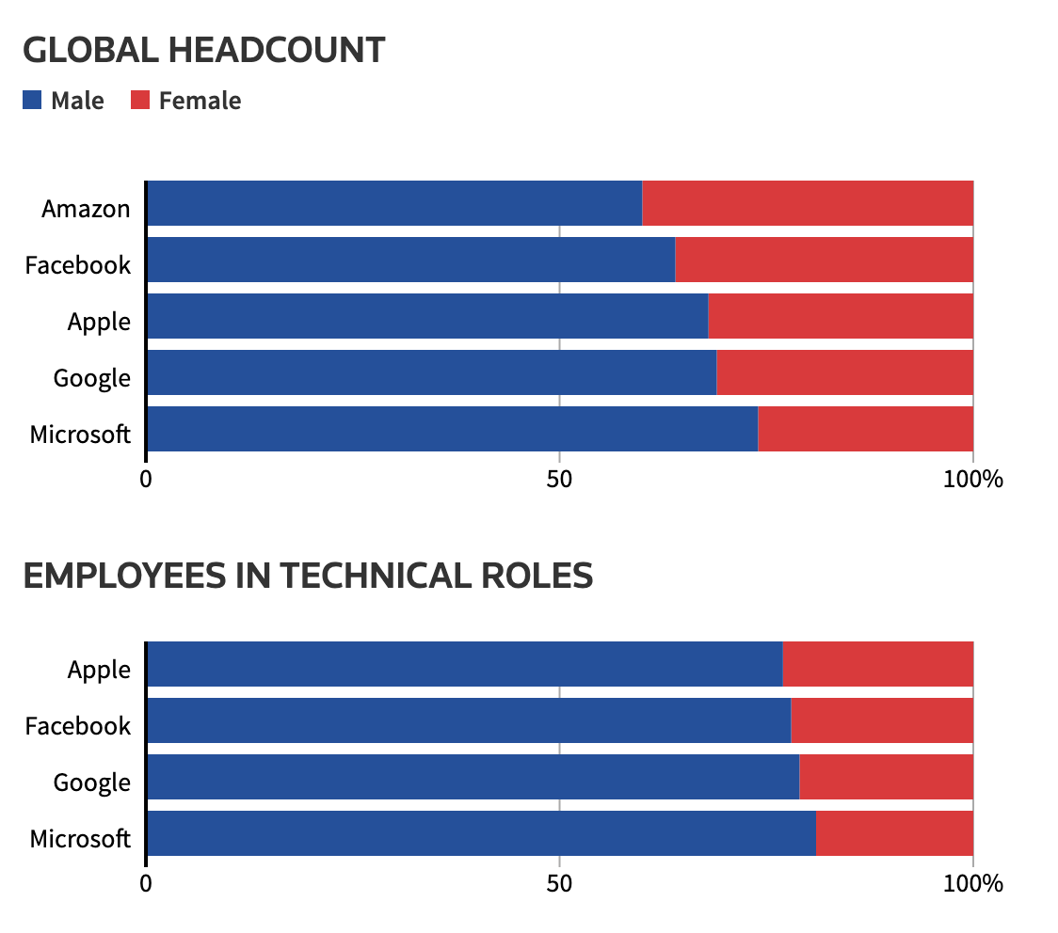
Bias in Machine Learning
Amazon HR hiring tool
“…Amazon's computer models were trained to vet applicants by observing patterns in resumes submitted to the company over a 10-year period. Most came from men, a reflection of male dominance across the tech industry. ”
Other examples of bias??
https://www.reuters.com/article/idUSKCN1MK0AG/
Notes:
Facial Recognition, voice recognition
Algorithms for sentencing (COMPASS)
Credit decisions…

Slide 24
CRISP: Deployment
How are you going to act on the outcome of your model?
What decisions will be made?
How will the success be measured?

Slide 25

Deployment
Your model and analysis are nothing without action.
Models might work great on paper but they don’t have business value until they get into production
Many things can go wrong on this step!
Communication is key
Especially to senior management
Tell stories with data
Monitor, monitor, monitor
Feedback loops!
[machine learning engineers deploying a model]
Data science and deployment teams should be integrated
Notes:
Requires teams to work well together, subject matter expertise on both sides! That is why having a range of knowledge from CS to stat is important!

Slide 26
Key Concept
The one most important aspect of every data science project
What action will you take?

Slide 27
Iterate …
Business Problem
Data
Action
Analysis
Notes:
So many focus on algorithm…but much much more
Must come back to Bus Und!!

Slide 28
Data Science Framework – In Action
Back to Nadia…
Notes:
Think through the steps…big problem, small problem…does solving the small problem impact the big problem?
Data – what are the most important things that might impact churn?
WHAT data would you aslk for – on whom (e.g. only those that left at end of contract?) First Contract?
How do you know who left?
In telecom, for various reasons, you don’t consider them “gone” until you go two bill cycles without them
How far back do you go?
Model – what are you training your data on…who is going to churn? Or who is going to take the offer?
Note – process returns probabilities…but you never observe them! How do you know if a probability is correct??
Evaluate: what is success? Taking the model, not churning, not churning after x months, what is the baseline
Deployment – what do you do if the customer is high risk but is already under contract?

Slide 29
Data Science – terminology

Slide 30
Taxonomy of Data Science tasks
Predictive
Descriptive
I would like to make predictions about data that I have seen or data that I will see
I would simply like to understand the data in front of me to comprehend more about a specific topic or situation
Examples
Most data science algorithms
Regression
Decision Trees
SVM (Support Vector Machines)
Neural Nets / Deep Learning
Reinforcement Learning
Examples:
Data Visualization
Clustering
Association Rules
Also: Inferential
- what statistics does
- infers relationships between attributes
Notes:
Point out that Predictive is best for your project!!

Slide 31

Predictions
A word about predictions:
Predictions do not have to be about the future
Predictions do not need to be causal to be useful
Predictions do not need to be perfect to be useful
For example, a diagnostic model identifying cancer is a “prediction”
It tells you nothing about the cause
It helps you decide on a future action
Prediction might be wrong, however more data can bring more certainty

Slide 32
Taxonomy of Data Science tasks
Supervised
Unsupervised
There is a specific, quantifiable target that we are interested in or trying to predict
There is no such target, we are just trying to understand the data
Predictions!
Patterns!
Lets predict which customers are going to buy our product based on browsing habits of our website!
Lets segment our customer base into clusters that will help us define broad persona-based marketing strategies
Might use the same data!

Slide 33
Supervised Learning
Supervised
Classification
Regression
Time series
Other…
Prediction variable is categorical (perhaps binary)
Prediction variable is numeric - continuous
Main data elements are time-based units
Predicting text or media…
Will the loan applicant default on their loan?
How much money will this customer spend on my product next year?
What will the DJIA close at next month?
What should my customer care chatbot say next?
Not cut and dried…tasks can fall between categories
Notes:
Don’t take this too seriously
sometimes you need to do both classification and regression...

Slide 34
Example
Loan Applicants – goal is to build a model to predict whether or not an applicant will default.
Data:
Name | Industry | Age | Date | Balance | Default
Mike | Finance | 30 | 02/13/04 | 123,000 | Yes
Mary | Medical | 40 | 29/06/13 | 51,100 | Yes
Bill | Construction | 55 | 14/08/09 | 68,000 | No
Jim | Medical | 46 | 01/01/07 | 74,000 | No
Mark | Finance | 47 | 23/12/11 | 23,000 | Yes
Anne | Finance | 49 | 19/0512 | 100,000 | No
Supervised or unsupervised?
Classification or regression?
What action might we take??
Notes:
Action…don’t accept the loan!
Model gives a probability
Put the model in the hands of the loan officer, who can make a judgement…

Slide 35
Supervised example
Loan Applicants – goal is to build a model to predict whether or not an applicant will default.
Data:
Variables
Attributes
Features
Independent Variables
Target
Dependent Variable
Identifier
Name | Industry | Age | Date | Balance | Default
Mike | Finance | 30 | 02/13/04 | 123,000 | Yes
Mary | Medical | 40 | 29/06/13 | 51,100 | Yes
Bill | Construction | 55 | 14/08/09 | 68,000 | No
Jim | Medical | 46 | 01/01/07 | 74,000 | No
Mark | Finance | 47 | 23/12/11 | 23,000 | Yes
Anne | Finance | 49 | 19/0512 | 100,000 | No
Observations
Instances
Data Points
Examples
X
Y

Slide 36
Model
Model: a method or algorithm used to generalize a pattern or make a prediction from a set of examples
Name | Industry | Age | Date | Balance | Default
Mike | Finance | 30 | 02/13/04 | 123,000 | Yes
Mary | Medical | 40 | 29/06/13 | 51,100 | Yes
Bill | Construction | 55 | 14/08/09 | 68,000 | No
Jim | Medical | 46 | 01/01/07 | 74,000 | No
Mark | Finance | 47 | 23/12/11 | 23,000 | Yes
Anne | Finance | 49 | 19/0512 | 100,000 | No
Algorithm:
Induces a function
from examples
Classification Model:
If Balance >= 50K and Age > 45
Then Default = ‘no’
Else Default = ‘yes’

Slide 37
Supervised Models
A model can be any function that takes inputs and makes a predictive output
Name | Age | Balance | Default
Mike | 30 | 123,000 | Yes
Mary | 40 | 51,100 | Yes
Bill | 55 | 68,000 | No
Jim | 46 | 74,000 | No
Mark | 47 | 23,000 | Yes
Anne | 49 | 100,000 | No
If Names starts with M
Then Default = ‘yes’
Else Default = ‘no’
Age is inversely proportional
to default
The model allows you to make predictions for cases you have not seen before (assuming the same data attributes)
If Balance >= 50K and Age > 45
Then Default = ‘no’
Else Default = ‘yes’
Notes:
Can they come up with them?

Slide 38
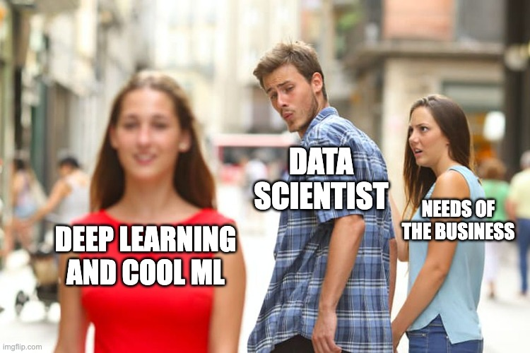
Caution
Data scientists can ”fall in love” with the data, or entranced with an algorithm
Remember the goal is always a business action – the data and the target need to be tied into the action you will take.

Slide 39
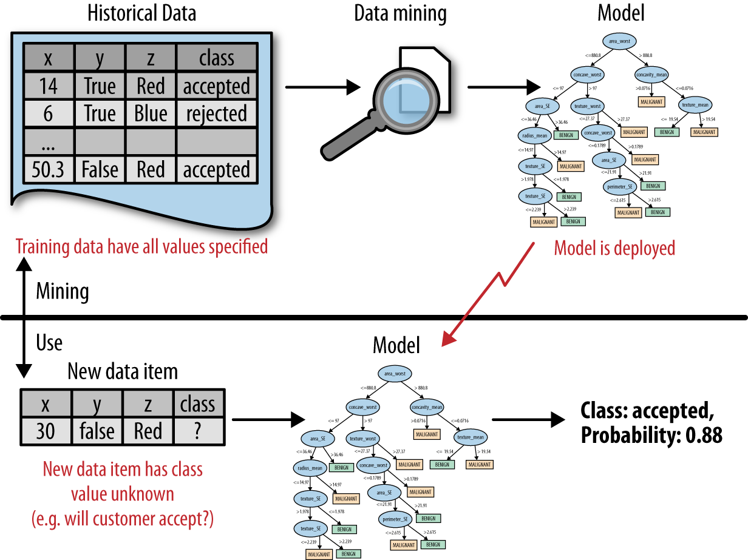
Back to the process …
DSB Fig2-1
Predictive analytics flow
data science / Learning / Training the model
Prediction
Decision/Action
“Send offer”
Using the model
Notes:
Put on board as data science vs use (deployment)
Data – science – selected mdlel
========================
New data – model – prediction – action (--outcome--feedback)
ML is a pogram that writes programs

